Slide 1

An animated wiki for the water cycle Geoscientific Project, a Media Project
Shihan Li
shihan@uni-bremen.de
Advisor: Dr. André Paul
Institution: Geoscience faculty, Universität Bremen
Period: 08.2019 – 11.2019

Slide 2
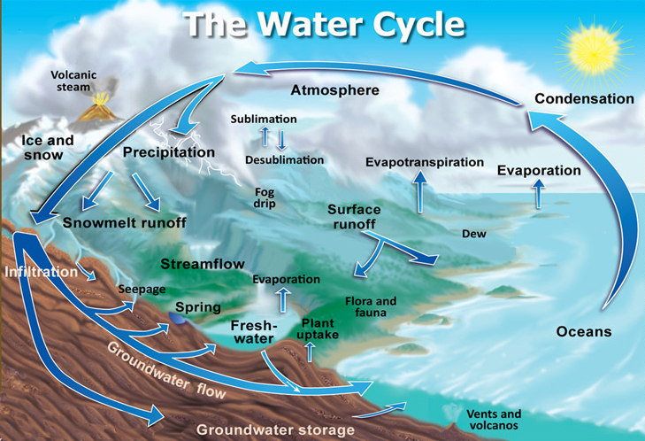


Existing wikis
For improvement
Little quantitative analysis
Poor data visualization
Key academic ideas missing
No temporal evolution
High school students
Undergraduates
Credit: John Evans and Howard Periman, USGS
Source: http://ga.water.usgs.gov/edu/watercycle.html

Slide 3
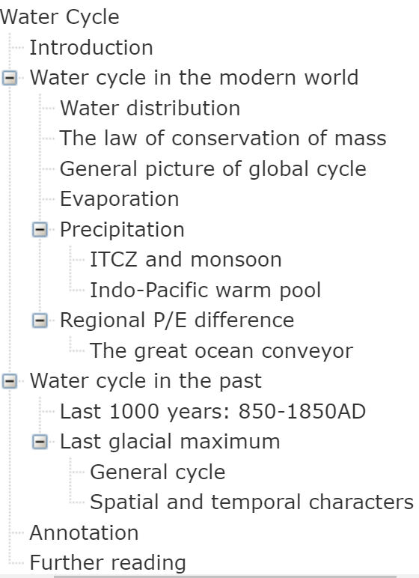
Aims
Logical flow
Analysis tool
Academic concepts
n
Temporal evolution
Animated figures

Slide 4
Data Source: TraCE-21ka Simulation
Covers the last 21,000 years
Of high quality
Annual, seasonal and monthly datasets P/E/wind velocity/SST/SSS
Data Visualization: Python
Tons of open-source packages
Strong capabilities for calculation and plotting
Professional platforms
Website build-up: HTML
Animation included
Easily accessed
More readable

Slide 5
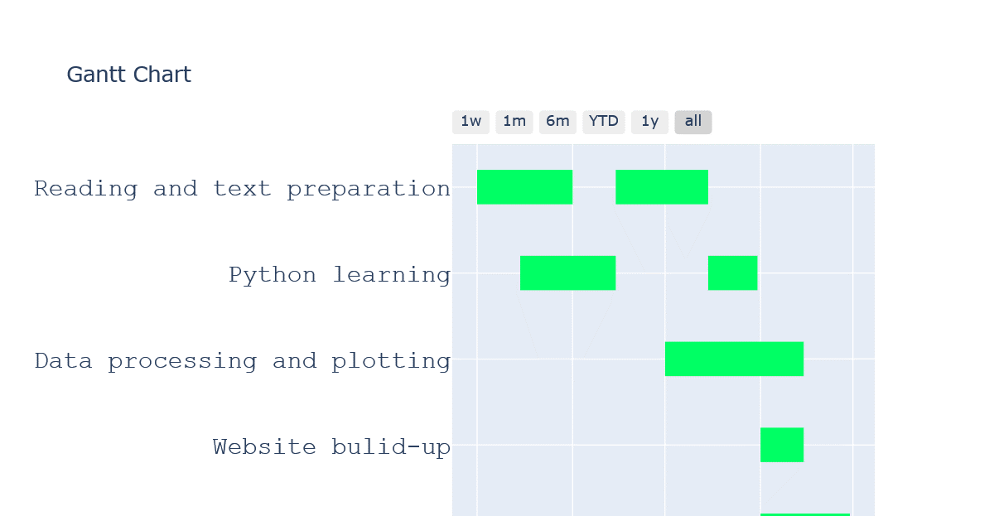

Slide 6
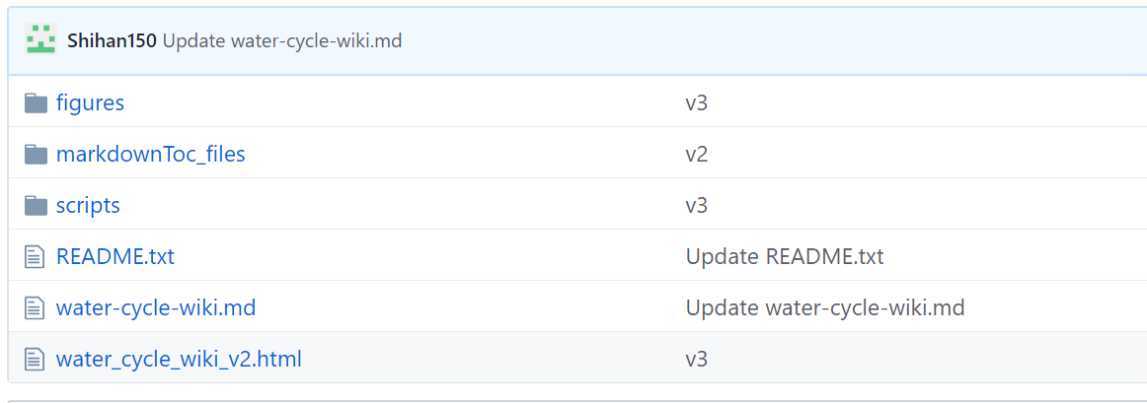
Product list
Github (Accessible for everyone!)
https://github.com/Shihan150/shihan.github.io
Scripts
Figures
All python codes
20 figures (19 + 1)
7 animated
HTML + markdownToc_files
Source code

Slide 7
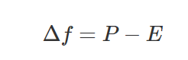
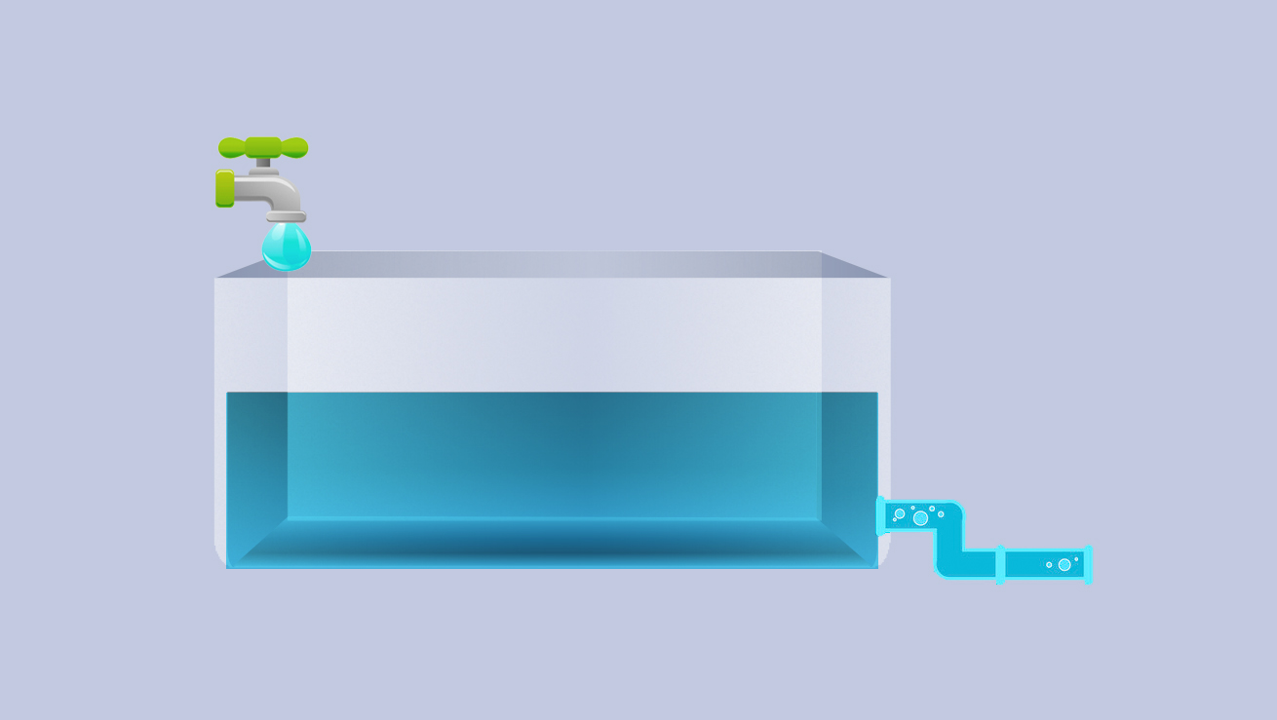
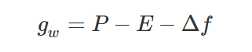
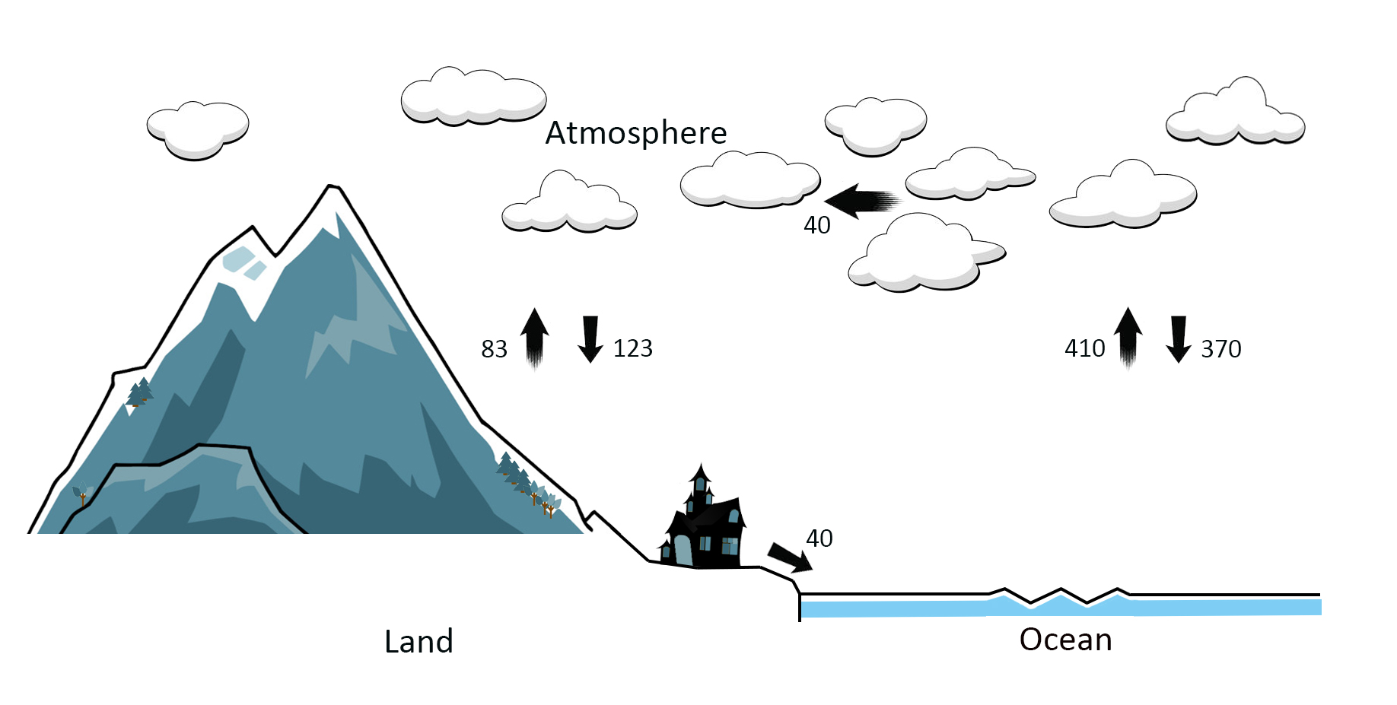
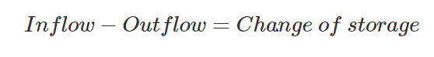
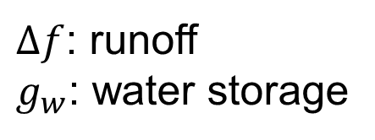
Analysis tool
The law of conservation of mass
$Δf$: runoff
$g_{w}$: water storage
Inflow
Storage
40
Outflow
83
123
370
410
40
Principle of the water balance between ocean and continent (in unit 10³ km³)

Slide 8
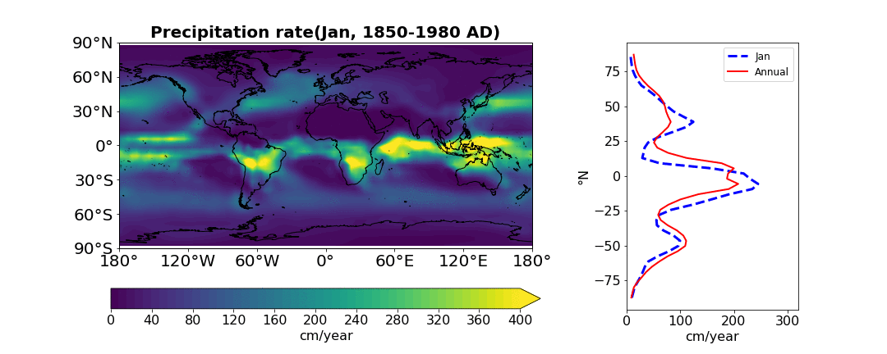
Academic concepts
Monthly P + matploblib.animation
ITCZ (maximum P belt)
Migrates seasonally
Monsoon

Slide 9
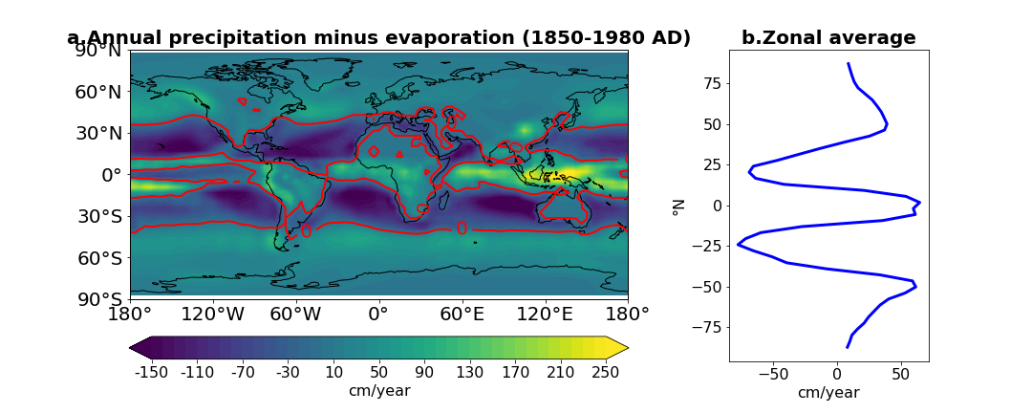
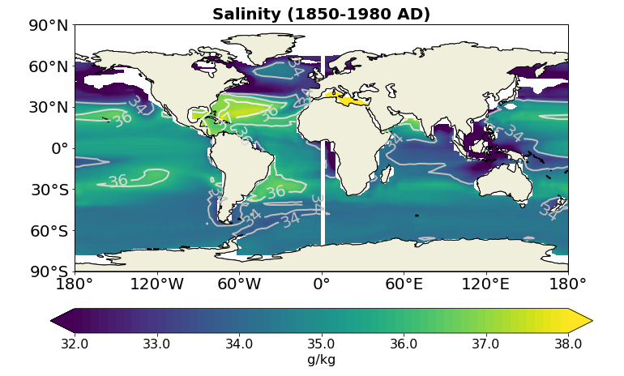
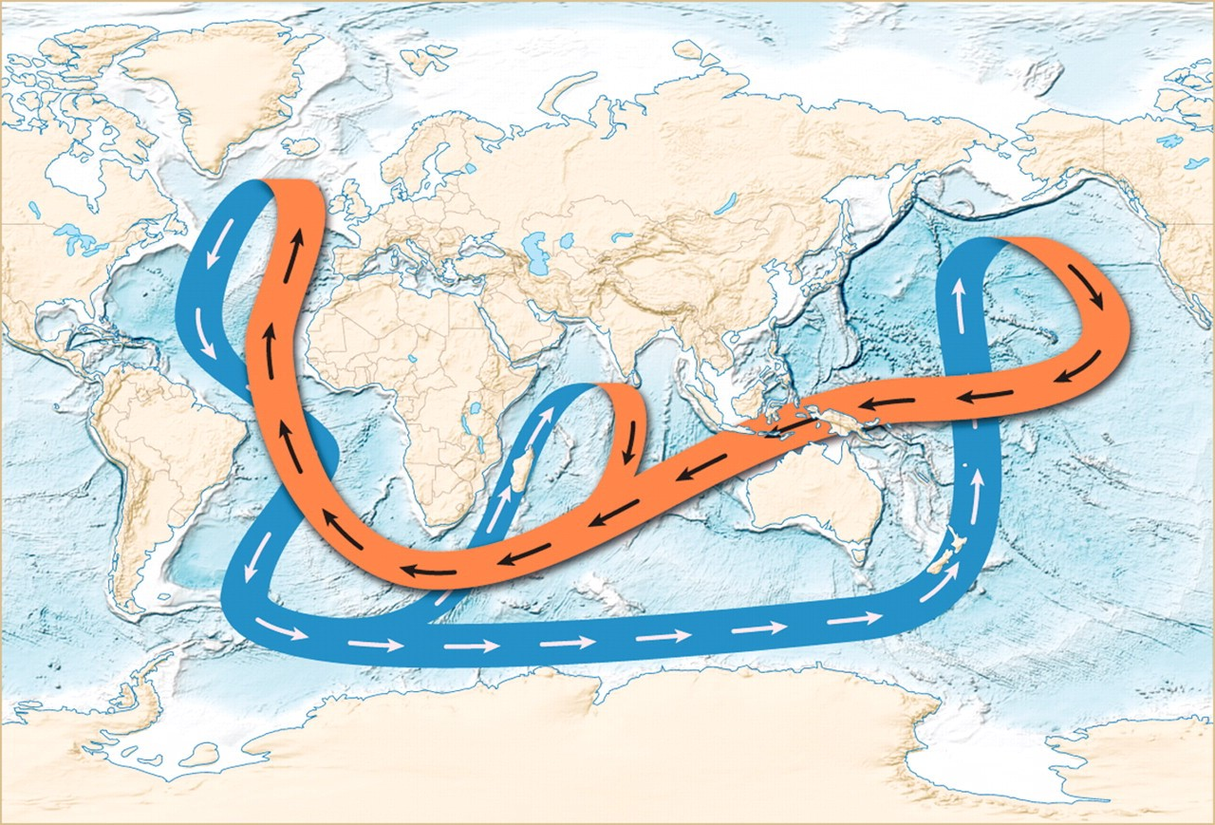
Academic concepts
P-E
Broecker, 1987, <Natural History Magazine>. Credit: Joe LeMonnier
The great ocean conveyor
Surface: Pacific → Atlantic
North Atlantic: Convection
Bottom: NA to other basins
Net freshwater/salt transport

Slide 10
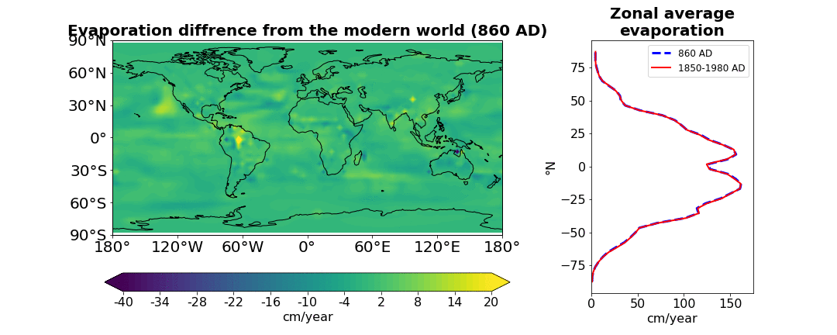
Temporal evolution
Almost same
Regional variations
Last 1kyr

Slide 11
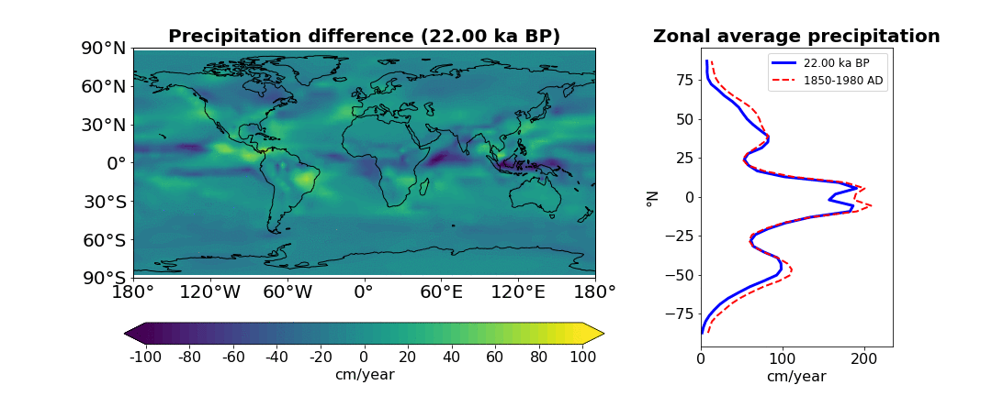
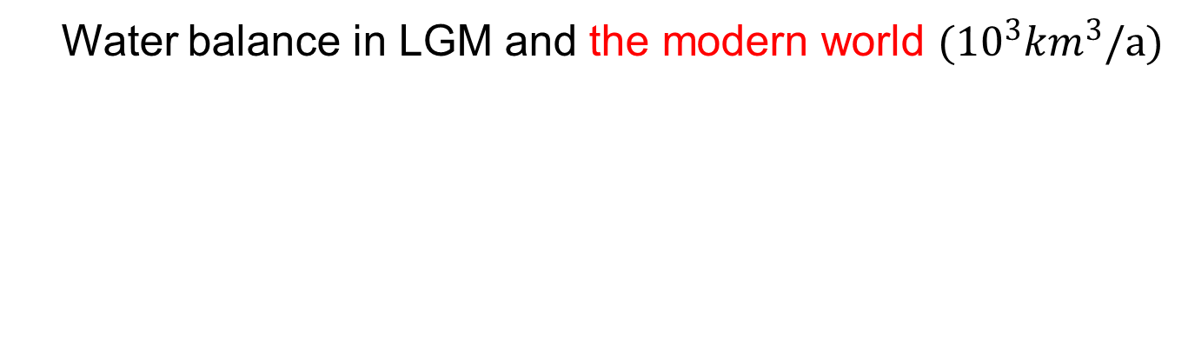
Temporal evolution
Water balance in LGM and the modern world $({10}^{3}{km}^{3}/a)$
Last Glacial Maximum
Slow down
Larger changes in ocean
Similar zonal pattern
Decrease in tropic and subpolar areas
Largest decrease

Slide 12
Aims |  | Self-evaluation
For readers | An animated wiki | ✔
 | Deeper understanding | ✔
 | Interest stimulation | ✔
For me | Python programing skills | ✔
 | Website build-up skills | ✔
Unexpected gain | Better review of this topic
 | Obtain some scientific insights
Outlook | Uploading, translation
In summary, this project is very rewardable!

Slide 13
Dr. André Paul
who gives me many invaluable suggestions and instructions
Dr. Feng He
who operated the TraCE-21ka simulation and make the results freely available
Shuquan Li, Xinyi Li
who help me design and improve some figures
Joe LeMonnier
who gives me the permission to use his classical diagram
Many colleagues (Siying Du, Mayur Parmar, Konstantinos Kostopoulos
et al.)
who provide me the feedback for the website and help improve it

Slide 14

PART
Q&A
02

Slide 15
PART
Appendix
02

Slide 16
TraCE-21ka Simulation
Model description
- Community Climate System Model version 3 (CCSM3), centered at the NCAR
- A global, coupled ocean-atmosphere-sea ice-land surface climate model
- Atmosphere resolution: 3.75° × 3.75° × 26 vertical layers
Forcing
- Orbital forcing, Atmospheric Greenhouse Gases,
Ice Sheets and Paleogeography, Meltwater Forcing.
Capability
- reproduces many major features of the deglacial climate evolution in Greenland,
Antarctica, the tropical Pacific, and the Southern and Deep Oceans.
More information on the setup of this simulation can be found in the Ph.D dissertation of Dr. Feng He (2011).
http://www.cgd.ucar.edu/ccr/TraCE/doc/He_PhD_dissertation_UW_2011.pdf

Slide 17
Hartmann, 1994. Chapter 5 in <Global Physical Climatology>.

Slide 18
Numpy - for calculation of matrix, arrays et al.
Matplotlib
- .pyplot, to plot the basic 2D, 3D figures
- .animation, to plot the animated figures
- .contour(f), to plot the contour figures
- .quiverkey, to plot the vector figures
Cartopy
- plot the base map for the spatial datasets
netCDF4
- read the data from .nc files
Main python packages used in this project

Slide 19
Web build-up
GitHub
- a repository for uploading materials
Markdown
- static website generator
Sublime text
- convert the .md file into .html

Slide 20
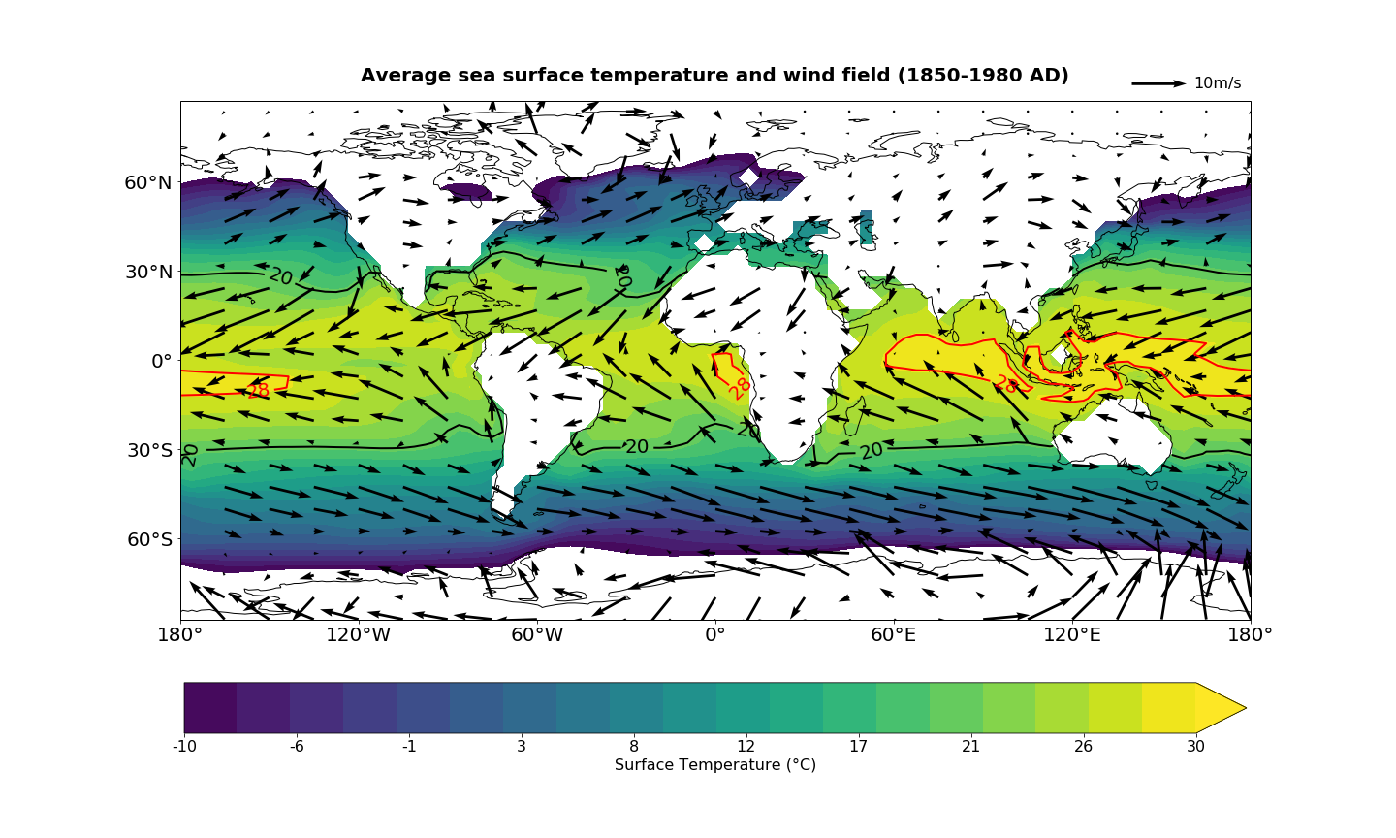

Slide 21
Simplified sketch of the global thermohaline circulation pathway (Rahmstorf, 2002. <Nature>)

Slide 22
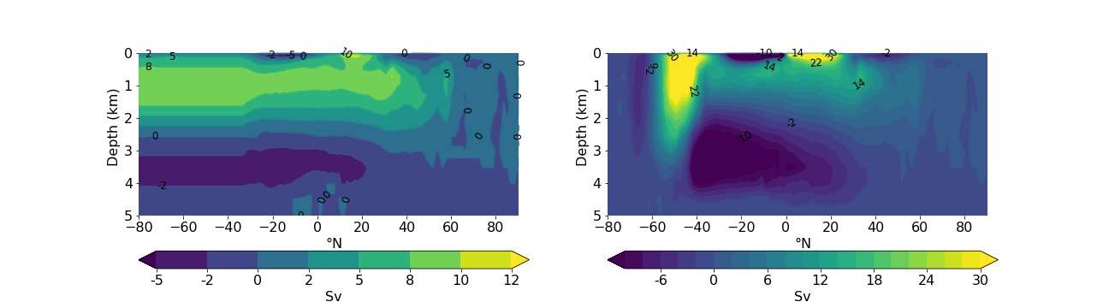
Annual-mean streamfunction (Sv, 1 Sv =10⁶m³/s) in Atlantic (left) and Pacific (right) ocean

Slide 23
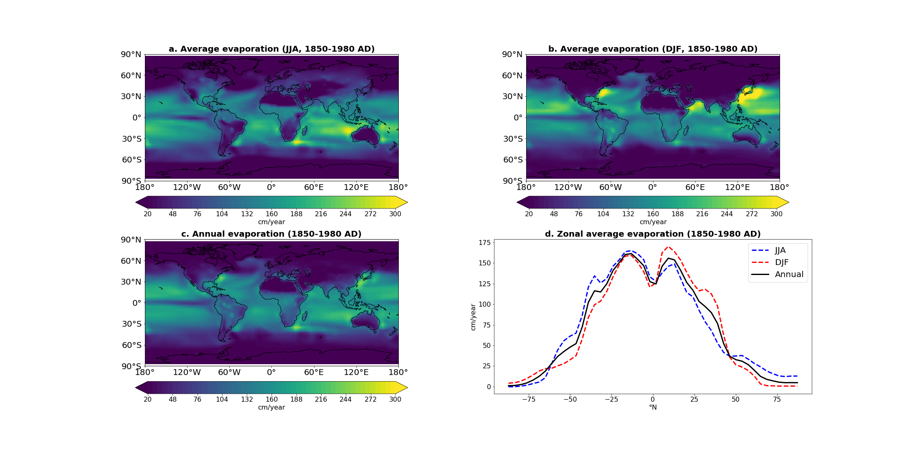
Winter intensification

Slide 24
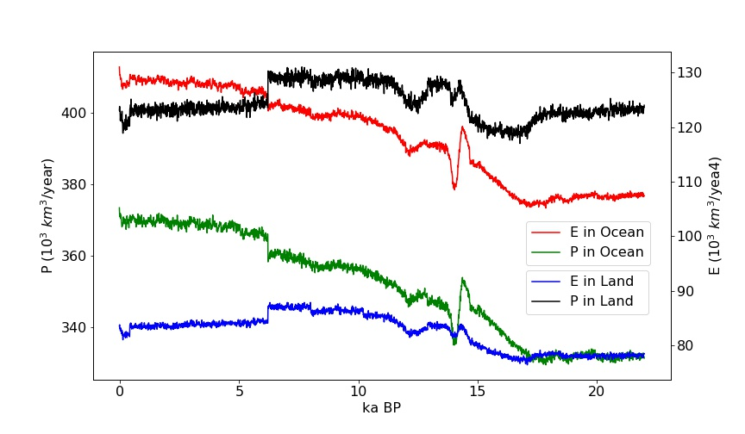

Slide 25
PART
Animated figures
02

Slide 26
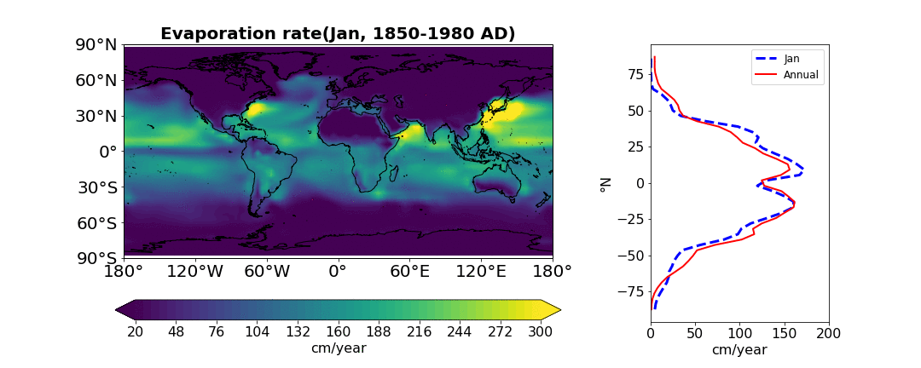

Slide 27
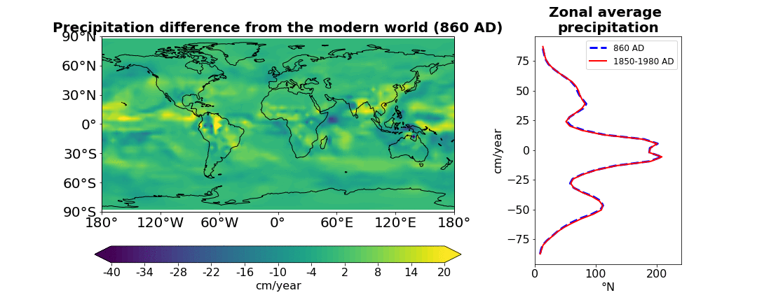
Last 1kyr

Slide 28
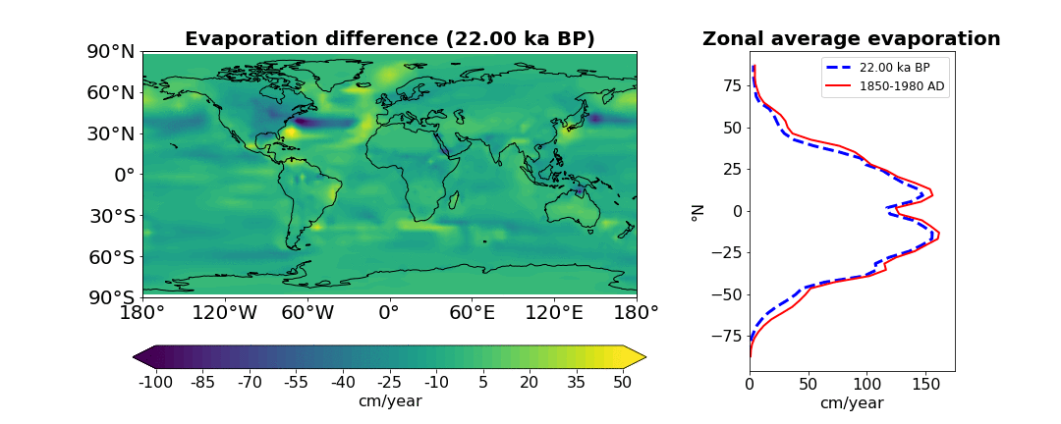
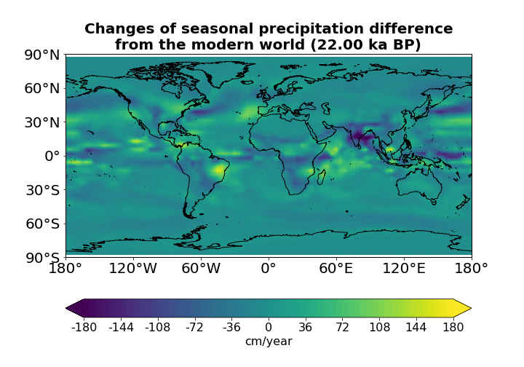
LGM

